Slide 1


Factors Affecting Student Performance
Insights from Stress, Lifestyle, Study Hours & Gender

Slide 2
Objective
Analyze how stress levels, lifestyle habits, daily study time, and gender influence students academic performance, measured by their grades.
Outcome
Stress management & a balanced lifestyle matter more that over studying
Quality study time over Sheer Quantity
Academic performance is gender-neutral

Slide 3
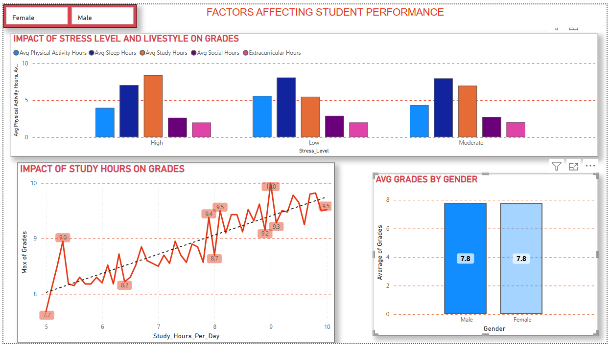
Dashboard

Slide 4
Conclusion
“Success Isn’t Gendered.”
Academic excellence thrives on a healthy mix of rest, focus, and balance.
Stress less, study smart, and live well to score high.

